Slide 1
Analysis of Ames Housing Data
Building lowest possible error regression model

Slide 2

Background
Sale price of residential property in Ames town, Iowa
2006 to 2010 period
Compiled by Prof. Dean de Cock
2051 training data
879 test data
81 attributes
79 quantity and quality attributes
2 identification columns
Notes:
Image obtained from Prof. Dean de Cock’s Linkedin https://www.linkedin.com/in/dean-de-cock-b5336537/

Slide 3
Workflow
Data and problem statement identification
Exploration
Cleaning and analysis
Model building and evaluation
Findings
Build regression model with least possible error
MSE as metric
Training and test data given
Data size and formats
Understanding attributes
Distribution and correlation of attributes
Various imputation methods for different missing data
Feature Engineering and removal
Linear Regression models
Regularised Regression model (LASSO/Ridge)
Identify best model
Identify key attributes affecting price

Slide 4
Problem statement
Develop regression model to predict house value in Ames city with the lowest possible error
Identifying key predictors that can highly influence housing prices.

Slide 5
Challenges
Mismatch in column names with data dictionary
Sale Condition not included
Interpretation of columns meaning
E.g. Lot Frontage
Missing data and selecting imputation methods
Nominal vs Ordinal vs Discrete vs Continuous
E.g. missing data for lot frontage

Slide 6
Modelling process
Step 5
Evaluate model on Kaggle with RMSE value
Step 1
Look at correlation plot to identify correlated features
Modellng process
Step 4
Fit using linear, LASSO and ridge regression and evaluate training RMSE
Step 2
Pick a subset of predictors
(20-40 predictors)
Step 3
Scale numerical predictors
(ordinal/discrete/continuous)

Slide 7
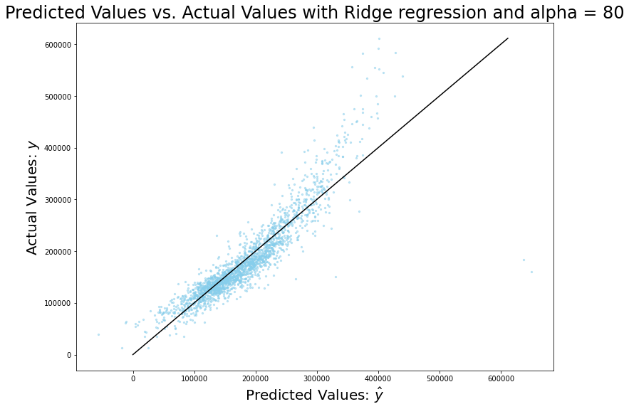
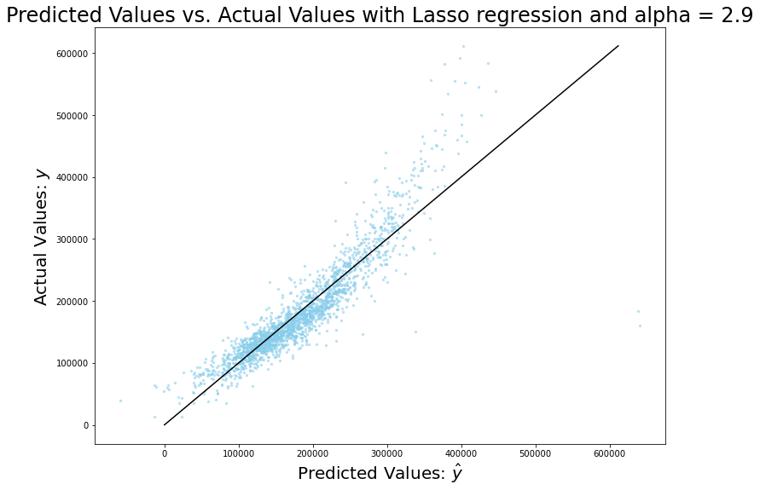
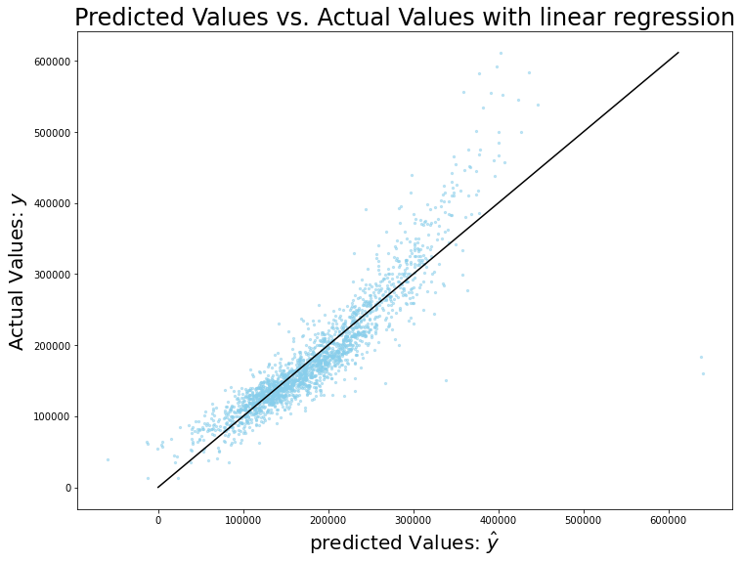
Model Performance
Training RMSE comparison
Ridge: 34615
Lasso: 35059
Linear Regression : 35070

Slide 8
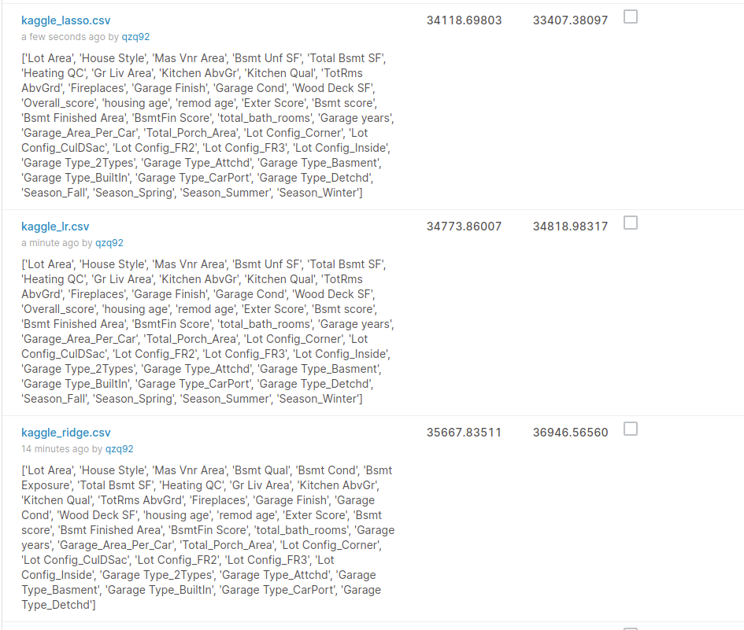
Model Performance
Lasso regression has the best Kaggle RMSE
RMSE: 33407, alpha = 2.9
Number of attributes: 40
Numerical: 24
Dummy encoded categories: 16
3 Categories (Season, Lot Config and Garage Type)

Slide 9
Findings and conclusion
Lasso Regression is the best compared with Ridge and Linear regression models
Three main attributes affecting price in absolute terms
Heating quality and condition (positive)
Total porch area (negative)
Wood deck area (positive)
Possible explanations
Natural disasters (floods, rainstorms)
Damage and destruction by natural disasters
Wood deck as insulator of heat and comfort

Slide 10
Analysis constraints and recommendations
Analysis bounded by given data
More granular data required
E.g buyer data, seller financial background and coordinates of home sales
Subsequent studies with granular data
Buyer and seller behaviours
Neighborhood

Slide 11
End

